Slide 1

North Western University, Khulna
Diabetes Prediction using Machine Learning and Deep Learning Algorithms
Presented By:
Tonoy Das
Student Id:20201087010
Department Of CSE
North Western University
Khulna, Bangladesh
May 06,2024

Slide 2
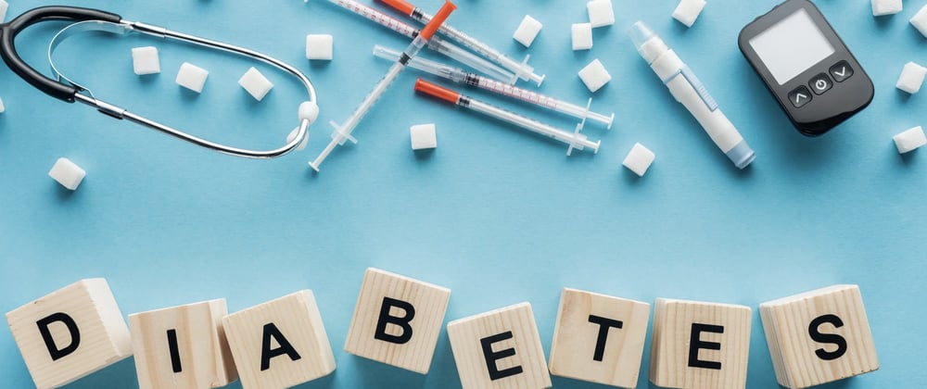
Overview
Introduction
Related Works
Objectives
Methodology
Results & Discussion
Conclusion
Future Works
References

Slide 3

Introduction
An imbalance in blood sugar control can lead to high blood glucose [1].
Insulin is a hormone that controls blood sugar levels.
It is increment day by day.
By 2035, this figure is expected to increase to 592 million [3].
In 2019, the disease affected nearly 7.10 million people in Bangladesh [4].

Slide 4
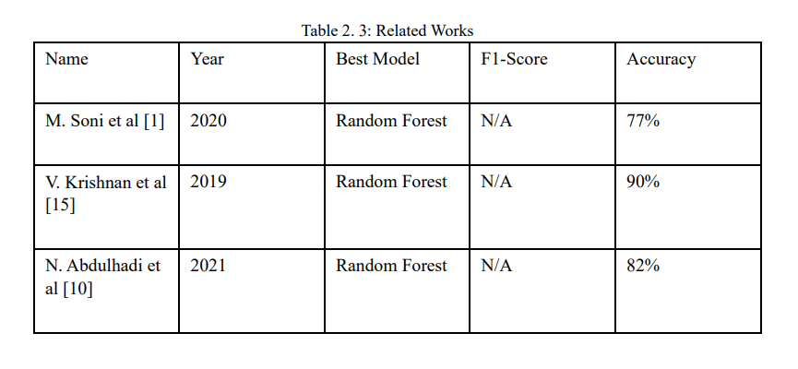
Related Works

Slide 5
Objectives
The main objectives of our thesis can be summarized as follows:
Model Analysis.
Compare ML and DL algorithms.
Improve accuracy.
Interpretability Analysis.
Recommendations and Future Directions.

Slide 6
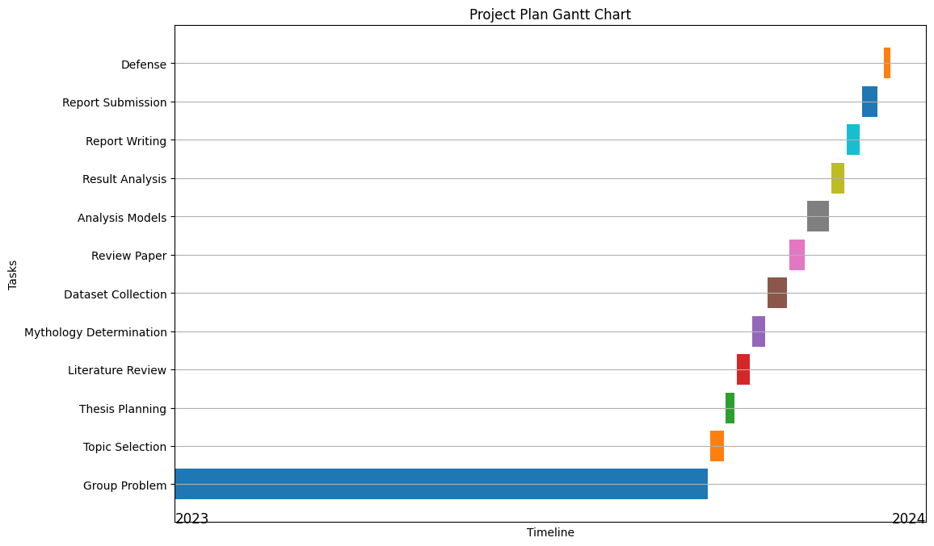
Project Planning
Figure 1: Gantt-Chart of the Project Plan

Slide 7
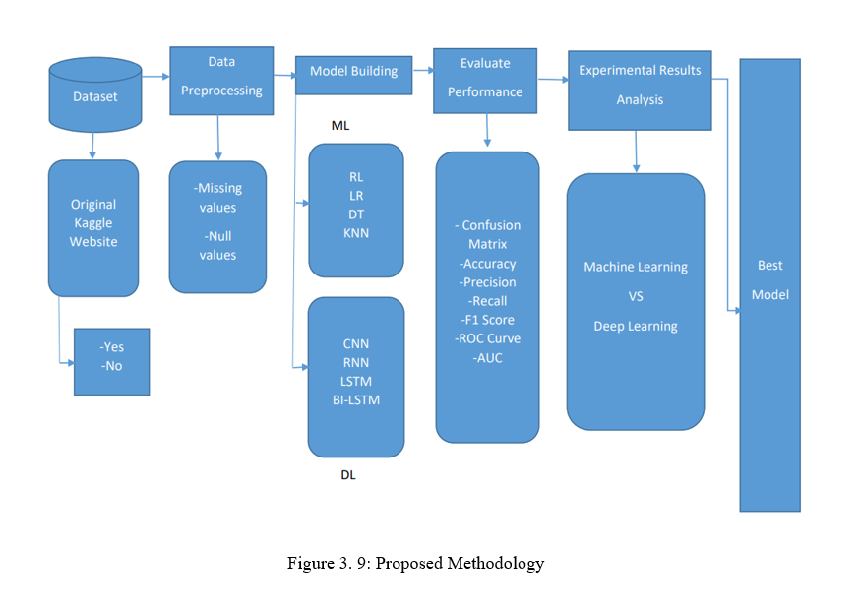
Methodology

Slide 8
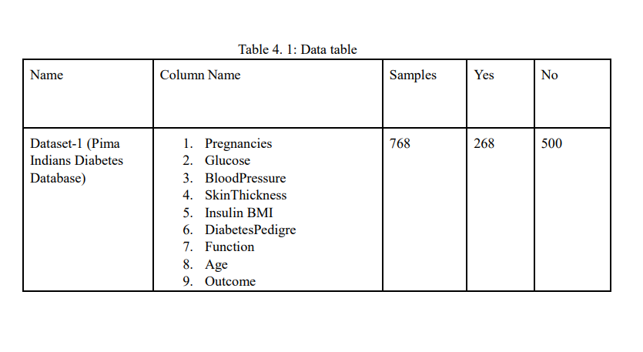
Dataset

Slide 9
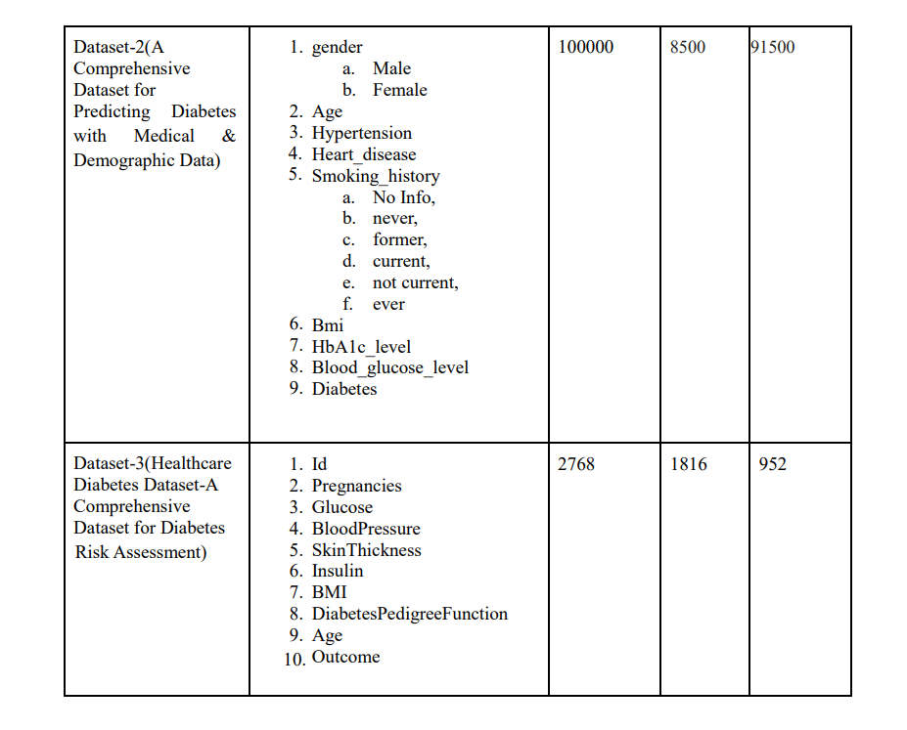
Dataset(cont.)

Slide 10
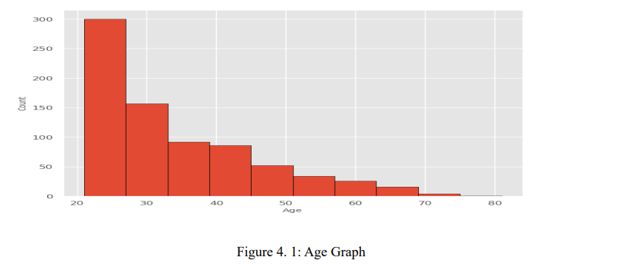
Implementation and Results
Dataset-1
The minimum age of this dataset is 21.
And the maximum age is 81.

Slide 11
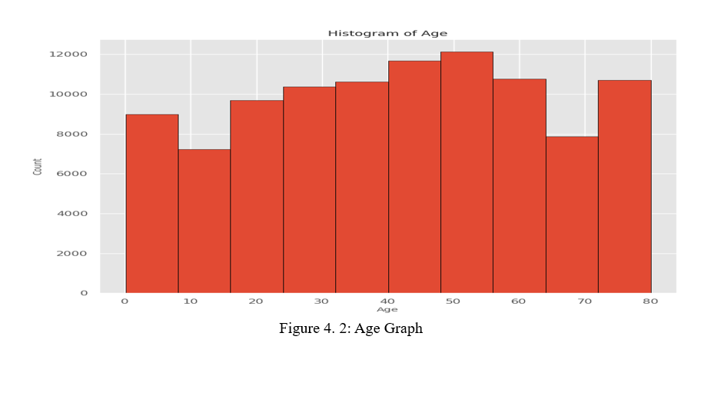
Implementation and Results(cont.)
Dataset-2
The minimum age of this dataset is 0.08.
And the maximum age is 80.

Slide 12
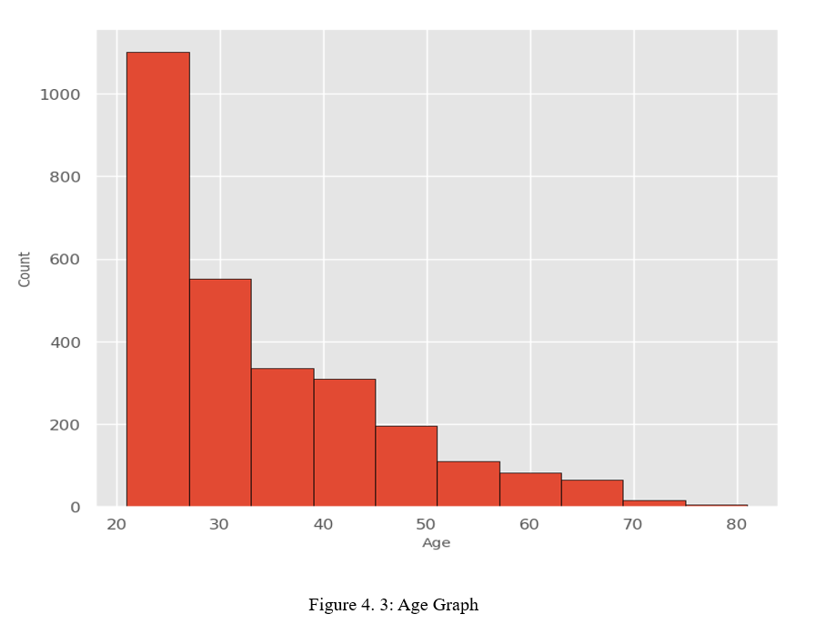
Implementation and Results(cont.)
Dataset-3
The minimum age of this dataset is 21.
And the maximum age is 81.

Slide 13
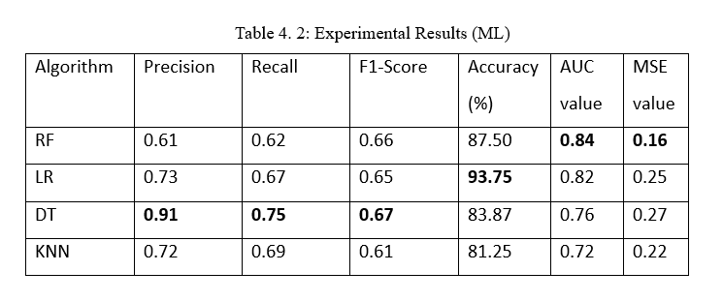
Experimental Results (ML)
Dataset-1

Slide 14
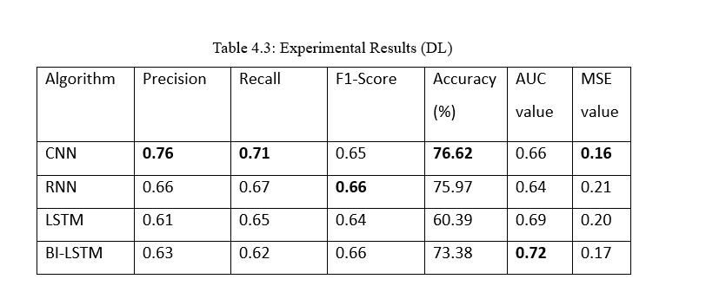
Experimental Results (DL)
Dataset-1

Slide 15
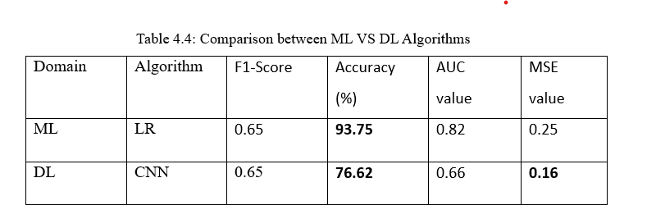
ML vs DL
Dataset-1

Slide 16
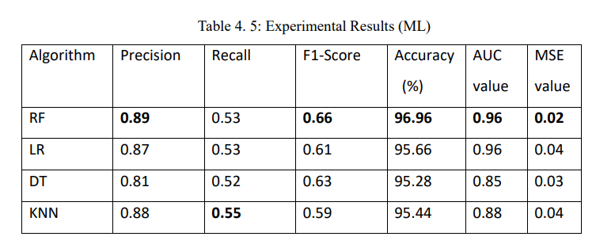
Experimental Results (ML)
Dataset-2

Slide 17
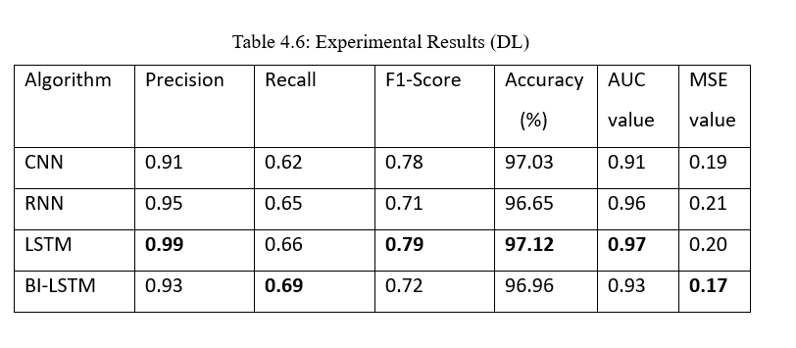
Experimental Results (DL)
Dataset-2

Slide 18
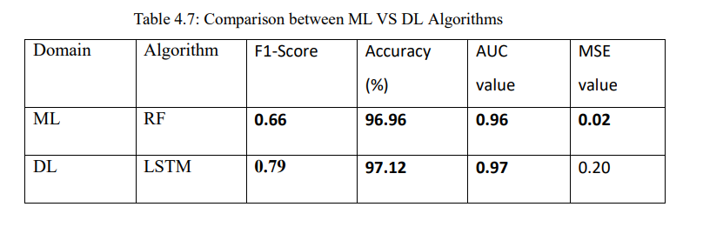
ML vs DL
Dataset-2

Slide 19
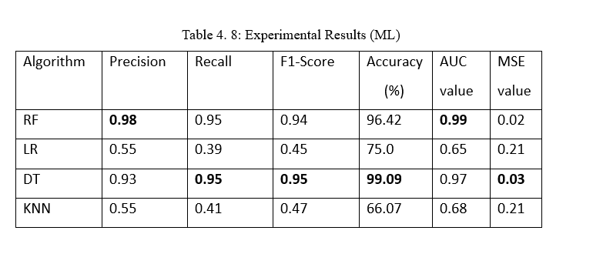
Experimental Results (ML)
Dataset-3

Slide 20
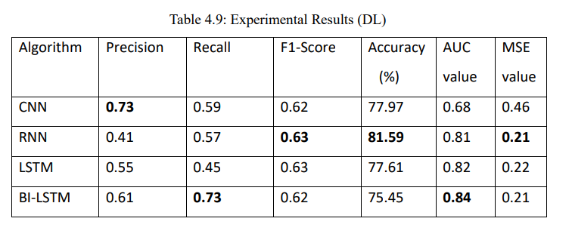
Experimental Results (DL)
Dataset-3

Slide 21
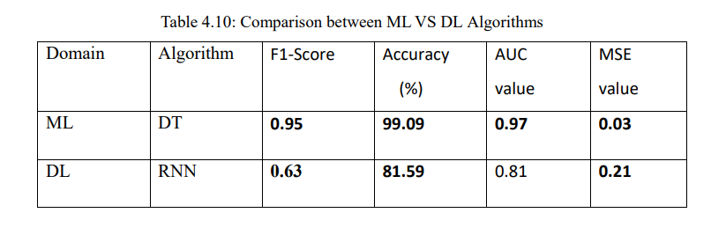
ML vs DL
Dataset-3

Slide 22
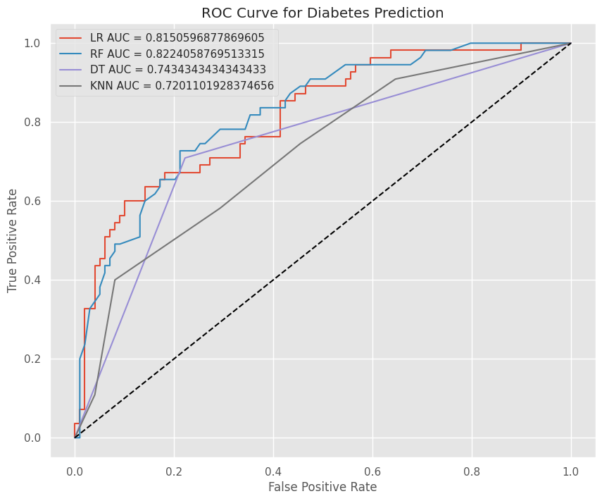
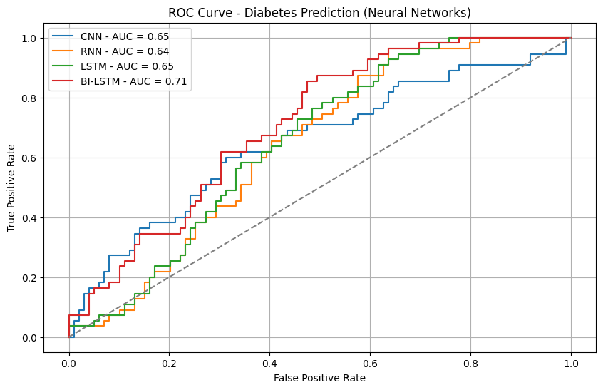
Experimental Results
Dataset-1
VS
Figure 4. 10: ML VS DL Roc Curve

Slide 23
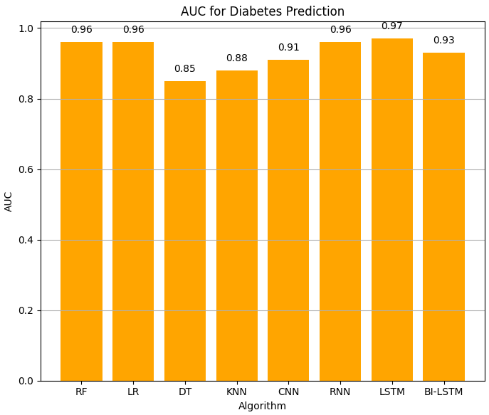
Experimental Results (Cont.)
Dataset-2
Figure 4. 17: AUC Graph

Slide 24
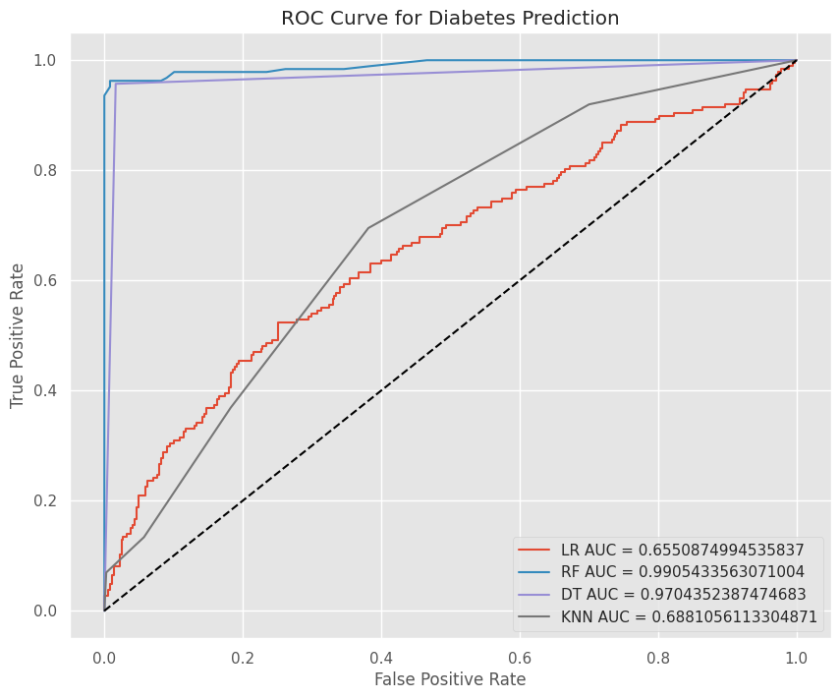
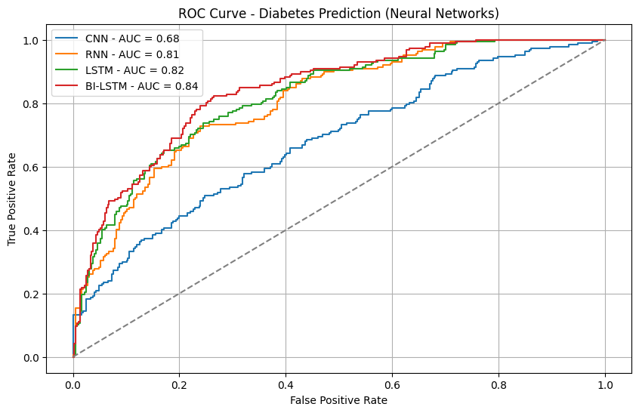
Experimental Results (Cont.)
Dataset-3
VS
Figure 4. 18: ML VS DL Roc Curve

Slide 25
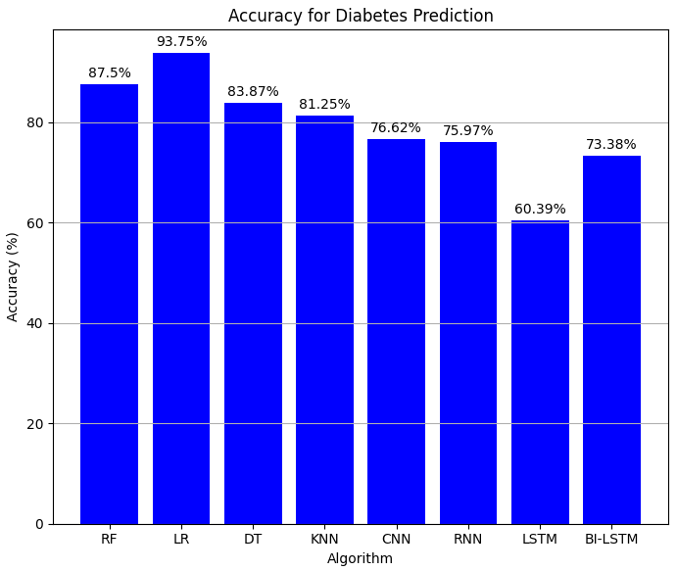
Experimental Results (Cont.)
Dataset-1
Figure 4. 12: Accuracy Graph

Slide 26
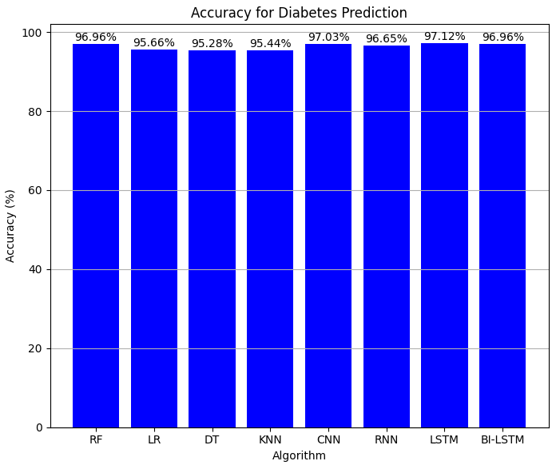
Experimental Results (Cont.)
Dataset-2
Figure 4. 16: Accuracy Graph

Slide 27
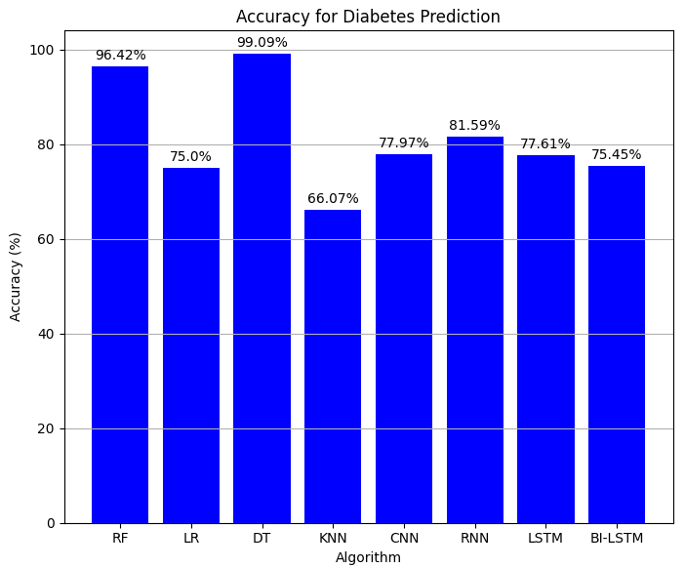
Experimental Results (Cont.)
Dataset-3
Figure 4. 20: Accuracy Graph

Slide 28
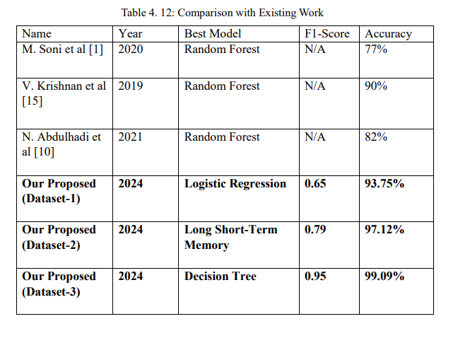
Comparison with Existing Work

Slide 29
Impact of the Project on Societal and Health
Societal Impact:
Improve healthcare openness.
Improve healthcare equity.
Addressing healthcare delivery.
Particularly in marginal groups.

Slide 30
Impact of the Project on Societal and Health (cont.)
Health Impact
Valuable impact for health outcomes.
Early identification.
It improves public health by bettering disease management.
Preventive actions.

Slide 31
Conclusion
Eight different machine learning and deep learning models are used.
LR achieves 93.75% and CNN 76.62% (Dataset-1).
RF achieves 96.96% and LSTM 97.12% (Dataset-2).
DT achieves 99.09% and RNN 81.59% (Dataset-3).
It reviews parameters such as accuracy and F1-score in detail.
Importance of Early Detection.
Healthcare applications, Uniquely in predicting diabetes.

Slide 32
Future Work
To Improve the Accuracy.
To work on a different Model.
Create a new data set.
Explainable AI techniques are vital in healthcare decision-making.
Medical images Improves the feature space.

Slide 33
References
[1] M. Soni and S. Varma, “Diabetes Prediction using Machine Learning Techniques,” International journal of engineering research and technology, vol. 9, 2020, [Online]. Available: https://api.semanticscholar.org/CorpusID:222201519
[2] A. Mujumdar and V. Vaidehi, “Diabetes Prediction using Machine Learning Algorithms,” Procedia Comput Sci, vol. 165, pp. 292–299, 2019, doi: https://doi.org/10.1016/j.procs.2020.01.047.
[3] F. G. Woldemichael and S. Menaria, “Prediction of Diabetes Using Data Mining Techniques,” 2018 2nd International Conference on Trends in Electronics and Informatics (ICOEI), pp. 414–418, 2018, [Online]. Available: https://api.semanticscholar.org/CorpusID:54219860
[10 ] N. Abdulhadi and A. Al-Mousa, “Diabetes detection using machine learning classification methods,” in 2021 International Conference on Information Technology (ICIT), 2021, pp. 350–354.
[15] V. Krishnan, B. Lavanya, I. Nirmala, and S. Caroline, “Random Forest Algorithm for the Prediction of Diabetes,” Feb. 2019, pp. 1–5. doi: 10.1109/ICSCAN.2019.8878802.

Slide 34
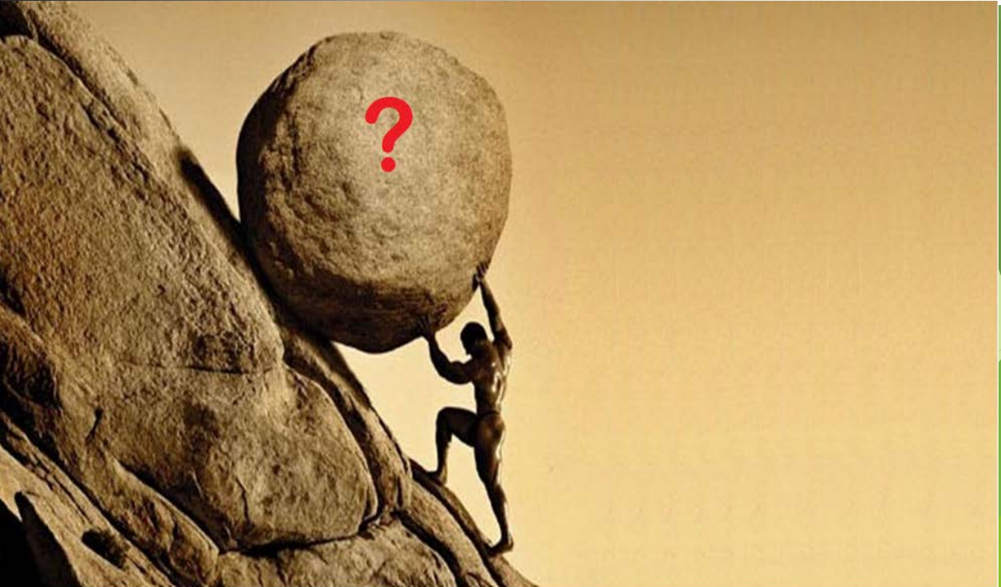
Thank you

